Slide 1


Slide 2
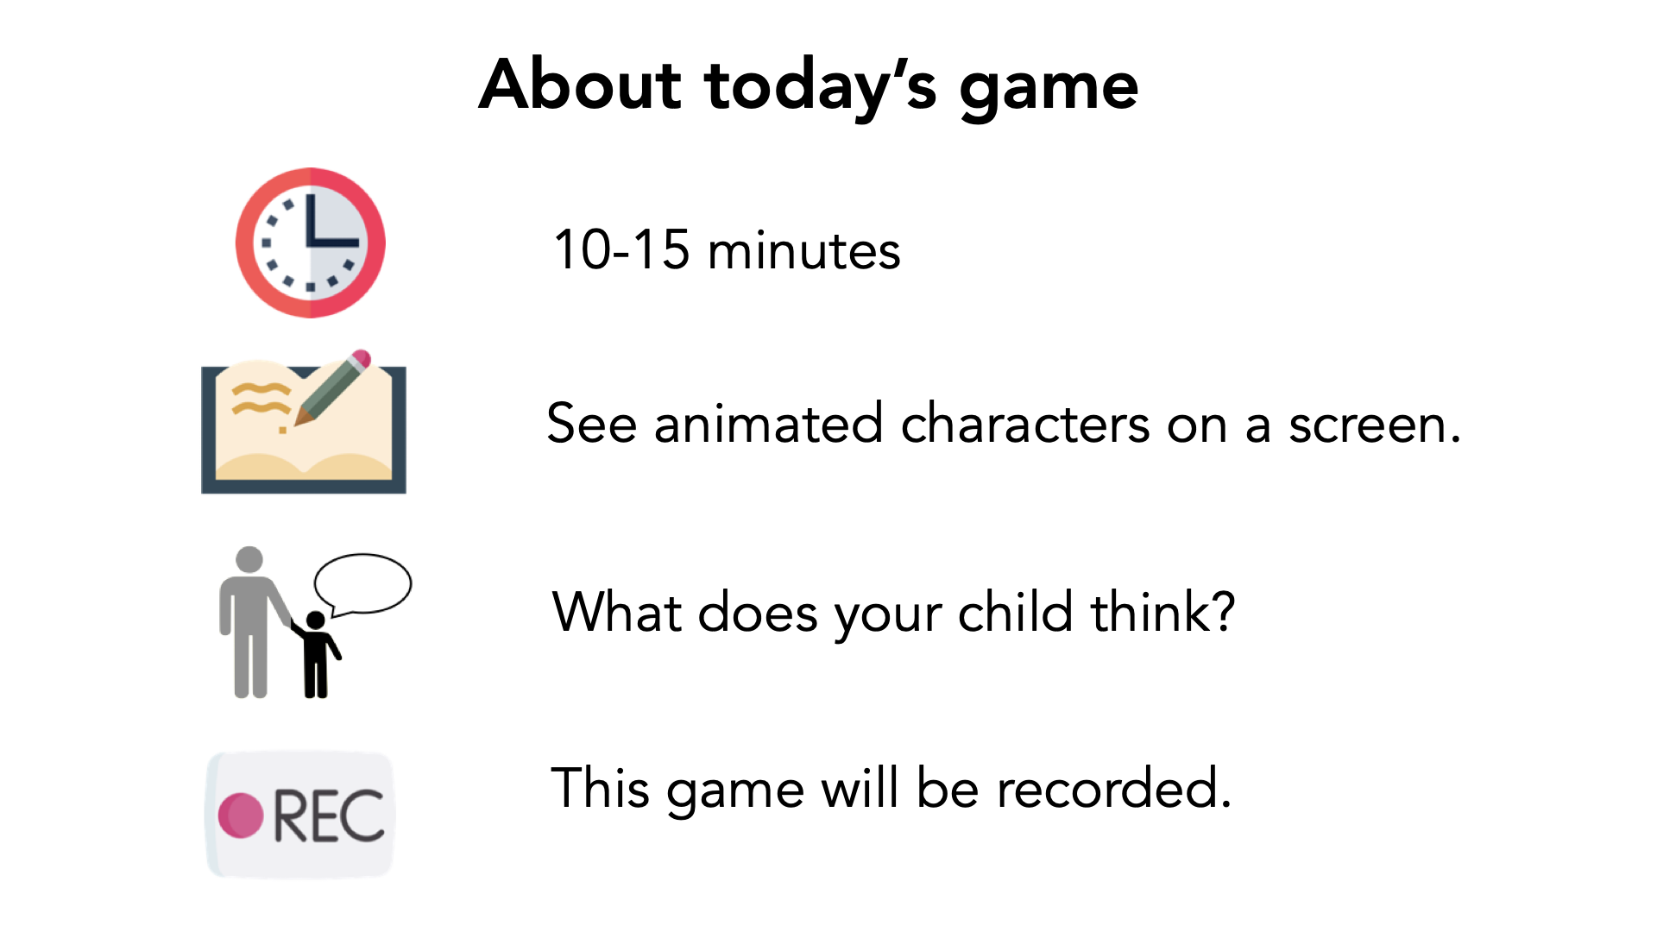

Slide 3
Verbal Consent
"I have read and understand the consent document. I am this child's parent or legal guardian and we both agree to participate in this study."

Slide 4


Slide 5

Notes:
This is Casey. I'm going to tell you a story about Casey.

Slide 6
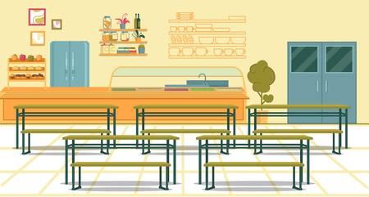

Notes:
This morning Casey felt sad, and Casey didn't know why.

Slide 7
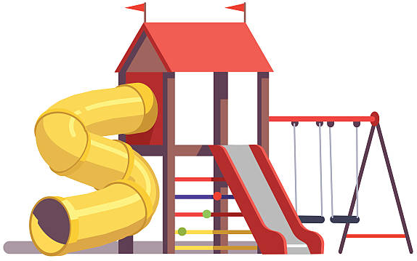

Notes:
And this afternoon Casey felt happy, and Casey didn't know why.

Slide 8


Notes:
After school, Casey saw a classmate named Blake. Blake said, "Hi Casey! How was school today?" Casey told Blake about feeling happy today.

Slide 9
Notes:
Casey did not tell Blake about feeling sad today.

Slide 10

Notes:
Then Casey saw another classmate named Morgan. Morgan said, "Hi Casey! How was school today?" Casey did not tell Morgan about feeling happy today.

Slide 11
Notes:
But Casey did tell Morgan about feeling sad today.

Slide 12

Notes:
Which classmate did Casey tell about feeling sad today? [memory check]

Slide 13
Who do you think is a better friend?
Notes:
Who do you think is a better friend to Casey? Why? [PRIMARY DV]

Slide 14

Notes:
Who do you think Casey would want to share an ice cream cone with? Why?

Slide 15

Notes:
Who do you think Casey would want to share candy with? Why?

Slide 16

Notes:
This is Rowan. I'm going to tell you a story about Rowan.

Slide 17

Notes:
Rowan feels sad today, and Rowan doesn't know why.

Slide 18
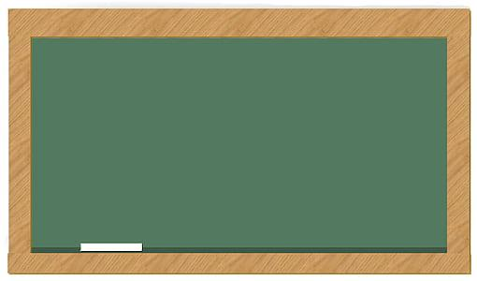


Notes:
In school today, Rowan found out that rabbits are Rowan's favourite animal.

Slide 19

Notes:
After school, Rowan saw a classmate named Jesse. Jesse said, "Hi Rowan! How was school today?" Rowan told Jesse about rabbits being Rowan's favourite animal.

Slide 20
Notes:
Rowan did not tell Jesse about feeling sad today.

Slide 21

Notes:
Then Rowan saw another classmate named Kai. Kai said, "Hi Rowan! How was school today?" Rowan did not tell Kai about rabbits being Rowan's favourite animal.

Slide 22
Notes:
But Rowan did tell Kai about feeling sad today.

Slide 23
Notes:
Which classmate did Rowan tell about feeling sad today? [memory check]

Slide 24
Who do you think is a better friend?
Notes:
Who do you think is a better friend to Rowan? Why? [PRIMARY DV]

Slide 25
Notes:
Who do you think Rowan would want to share an ice cream cone with? Why?

Slide 26
Notes:
Who do you think Rowan would want to share candy with? Why?

Slide 27

Notes:
This is Percy. I'm going to tell you a story about Percy.

Slide 28

Notes:
Percy feels sad today, and Percy doesn't know why.

Slide 29
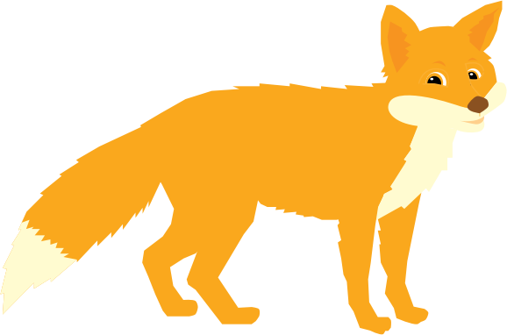
Notes:
In school today, Percy learned that foxes move without making any sound.

Slide 30

Notes:
After school, Percy saw a classmate named Avery. Avery said, "Hi Percy! How was school today?" Percy told Avery about how foxes move without making any sound.

Slide 31
Notes:
Percy did not tell Avery about feeling sad today.

Slide 32

Notes:
Then Percy saw another classmate named Orin. Orin said, "Hi Percy! How was school today?" Percy did not tell Orin about how foxes move without making any sound.

Slide 33
Notes:
But Percy did tell Orin about feeling sad today.

Slide 34
Notes:
Which classmate did Percy tell about feeling sad today? [memory check]

Slide 35
Who do you think is a better friend?
Notes:
Who do you think is a better friend to Percy? Why? [PRIMARY DV]

Slide 36

Notes:
This is Devon. I'm going to tell you a story about Devon.

Slide 37

Notes:
Devon feels happy today, and Devon doesn't know why.

Slide 38

Notes:
In school today, Devon found out that owls are Devon's favourite animal.

Slide 39

Notes:
After school, Devon saw a classmate named Harper. Harper said, "Hi Devon! How was school today?" Devon told Harper about owls being Devon's favourite animal.

Slide 40
Notes:
Devon did not tell Harper about feeling happy today.

Slide 41

Notes:
Then Devon saw another classmate named Quinn. Quinn said, "Hi Devon! How was school today?" Devon did not tell Quinn about owls being Devon's favourite animal.

Slide 42
Notes:
But Devon did tell Quinn about feeling happy today.

Slide 43
Notes:
Which classmate did Devon tell about feeling happy today? [memory check]

Slide 44
Who do you think is a better friend?
Notes:
Who do you think is a better friend to Devon? Why? [PRIMARY DV]

Slide 45

Notes:
This is Kendall. I'm going to tell you a story about Kendall.

Slide 46

Notes:
Kendall feels happy today, and Kendall doesn't know why.

Slide 47
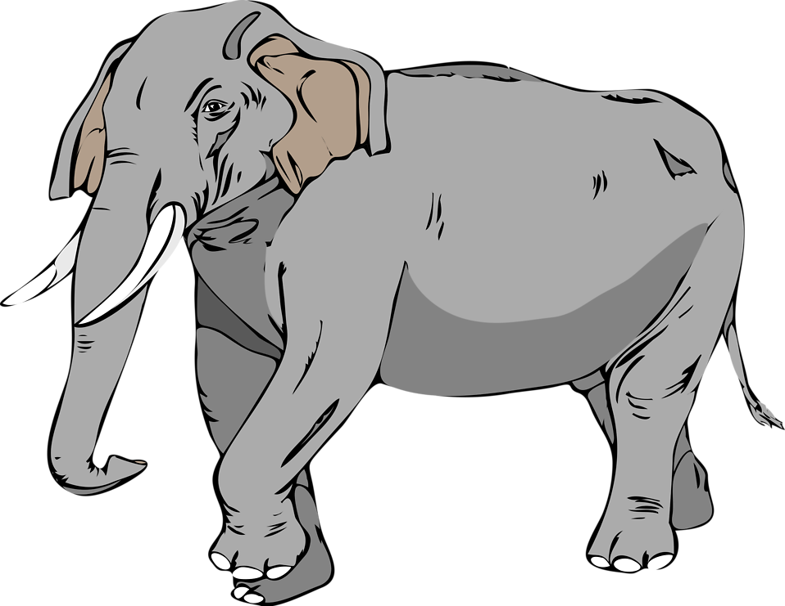
Notes:
In school today, Kendall learned that elephants move mostly in the morning.

Slide 48

Notes:
After school, Kendall saw a classmate named Riley. Riley said, "Hi Kendall! How was school today?" Kendall told Riley about how elephants move mostly in the morning.

Slide 49
Notes:
Kendall did not tell Riley about feeling happy today.

Slide 50

Notes:
Then Kendall saw another classmate named Cameron. Cameron said, "Hi Kendall! How was school today?" Kendall did not tell Cameron about how elephants move mostly in the morning.

Slide 51
Notes:
But Kendall did tell Cameron about feeling happy today.

Slide 52
Notes:
Which classmate did Kendall tell about feeling happy today? [memory check]

Slide 53
Who do you think is a better friend?
Notes:
Who do you think is a better friend to Kendall? Why? [PRIMARY DV]

Slide 54

Notes:
This is Jamie. I'm going to tell you a story about Jamie.

Slide 55

Notes:
In school today, Jamie found out that owls are Jamie's favourite animal.

Slide 56
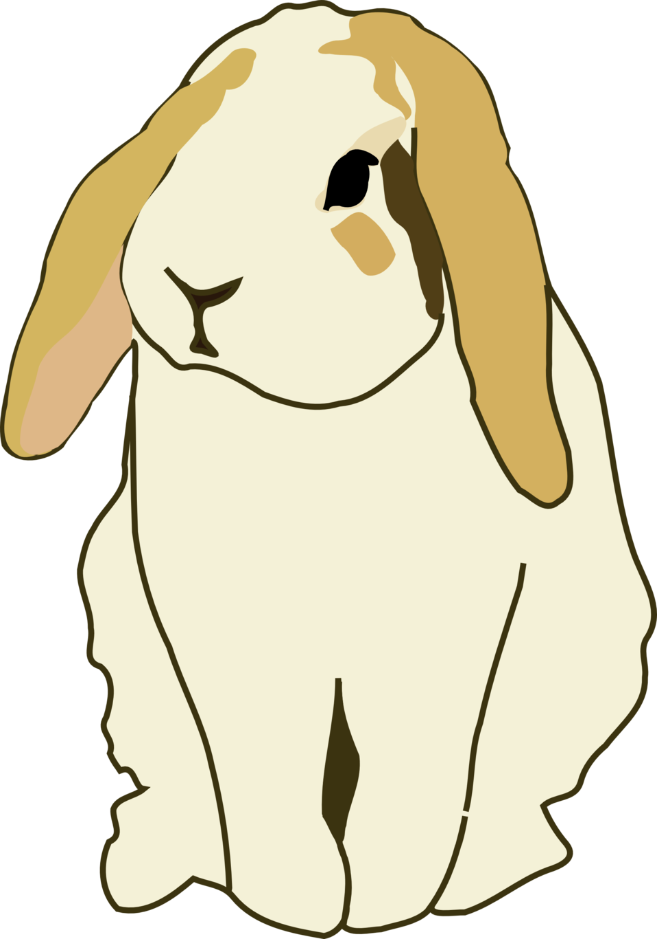
Notes:
In school today, Jamie learned that rabbits move by hopping on their back legs.

Slide 57

Notes:
After school, Jamie saw a classmate named Elliot. Elliot said, "Hi Jamie! How was school today?" Jamie told Elliot about how rabbits move by hopping on their back legs.

Slide 58
Notes:
Jamie did not tell Elliot about owls being Jamie's favourite animal.

Slide 59

Notes:
Then Jamie saw another classmate named Parker. Parker said, "Hi Jamie! How was school today?" Jamie did not tell Parker about how rabbits move by hopping on their back legs.

Slide 60
Notes:
But Jamie did tell Parker about owls being Jamie's favourite animal.

Slide 61
Notes:
Which classmate did Jamie tell about the owls? [memory check]

Slide 62
Who do you think is a better friend?
Notes:
Who do you think is a better friend to Jamie? Why? [PRIMARY DV]

Slide 63
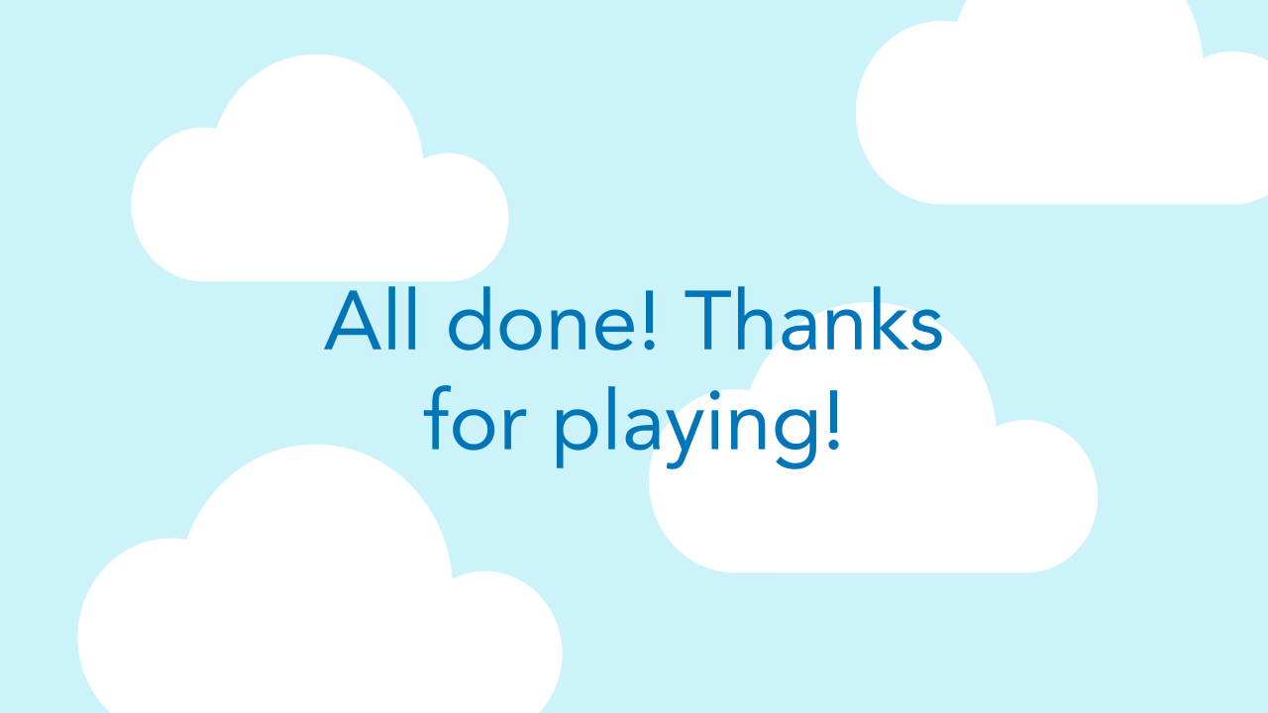

Slide 64
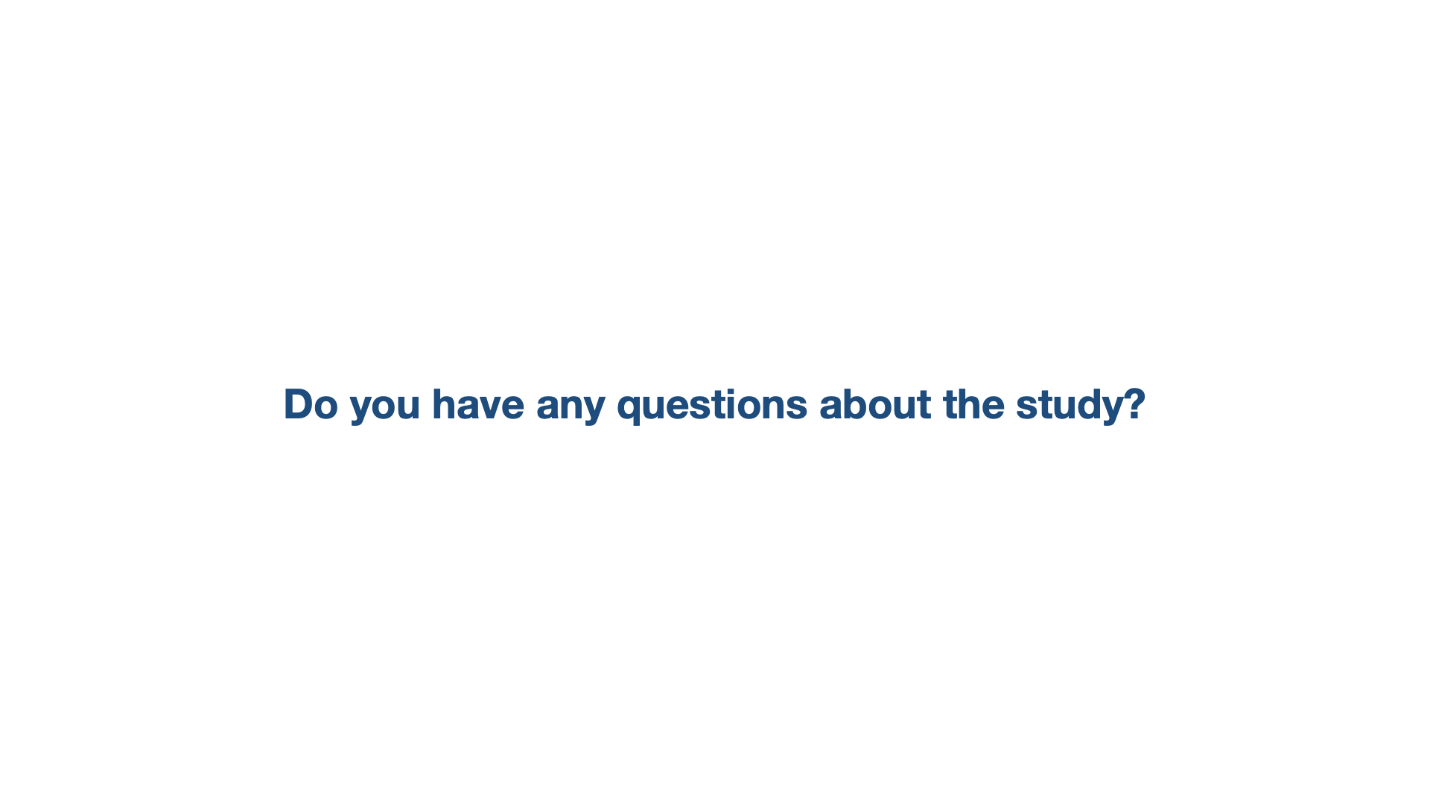

Slide 65
